Slide 1
Progress check
Module 1
Class 7

Slide 2
What should we do today:
To remeber and to improve our vocabulary from the first module;
To do exercises with the vocabulary (Translate from Russian into English/ Fill in the gaps/ Choose the correct word (pronoun)
To remind where SHOULD we can use/ what’s the difference between P.S and Pr.C and do grammar exs.

Slide 3
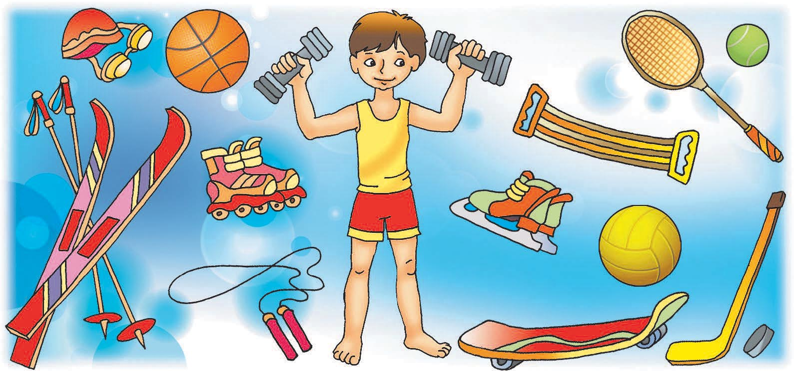
Lead healthy lifestyle

Slide 4
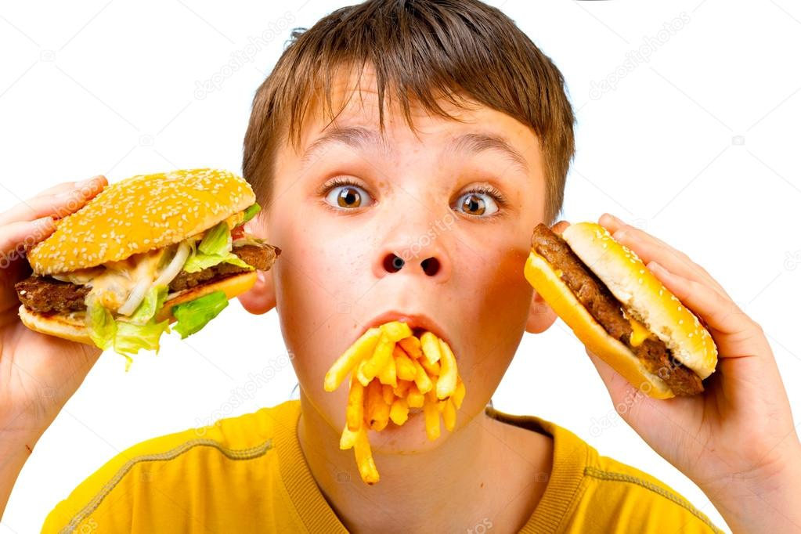
Lead unhealthy lifestyle

Slide 5
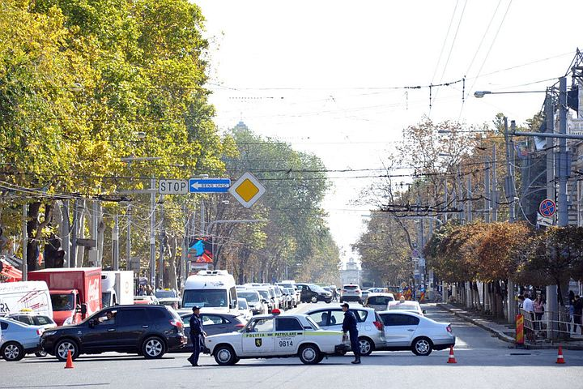
Heavy traffic

Slide 6
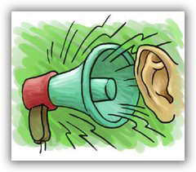
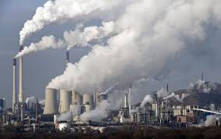
Constant noise
and pollution

Slide 7
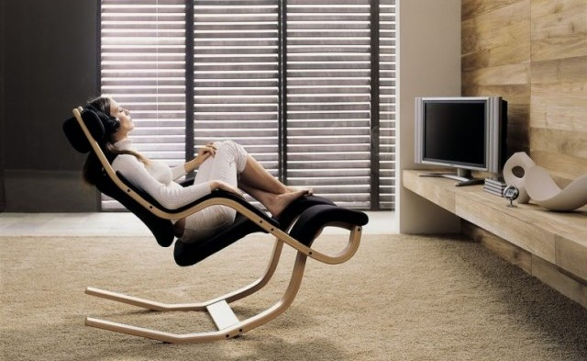
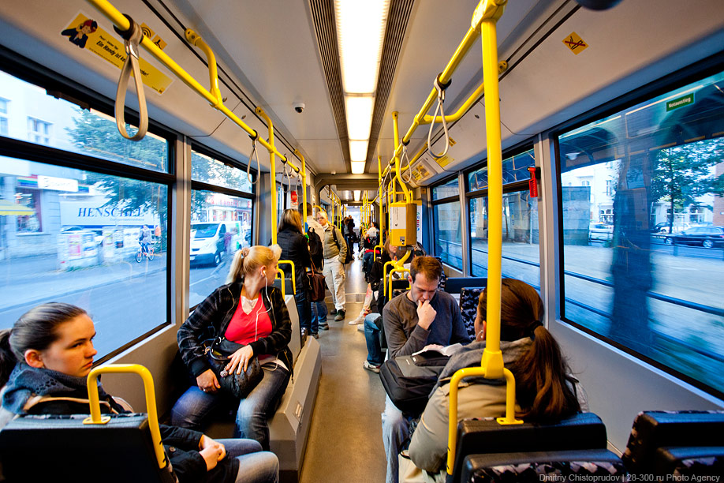
Convenient
public transport

Slide 8
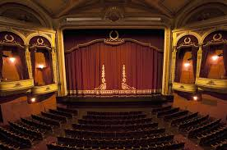
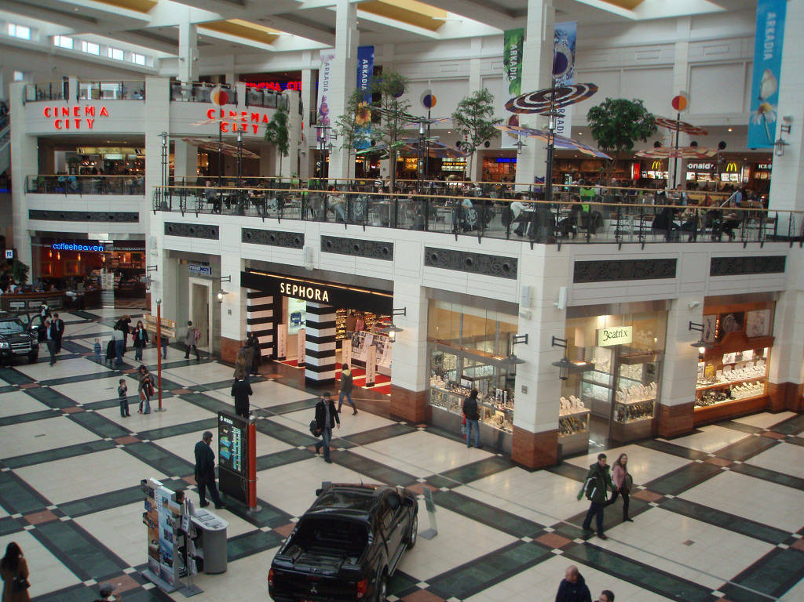
Shops,
cinemas
and theatres

Slide 9
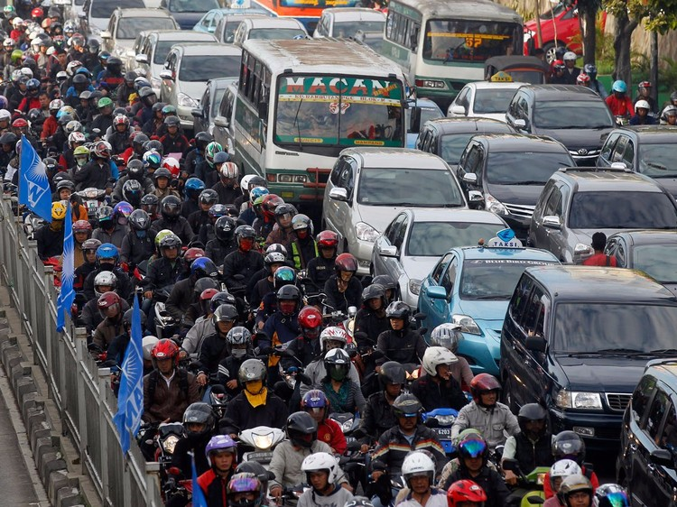
Crowded streets

Slide 10
High quality of lifestyle High cost of living

Slide 11
Fresh air

Slide 12
Feeling isolated

Slide 13
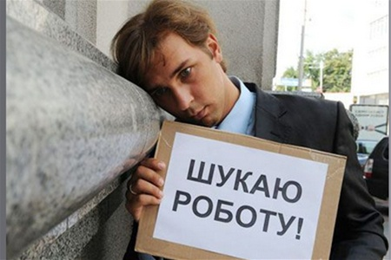
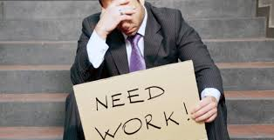
High rate of unemployment

Slide 14
Low rate of unemployment

Slide 15
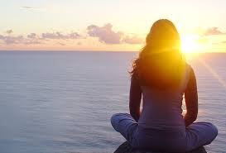
Peace and quite

Slide 16
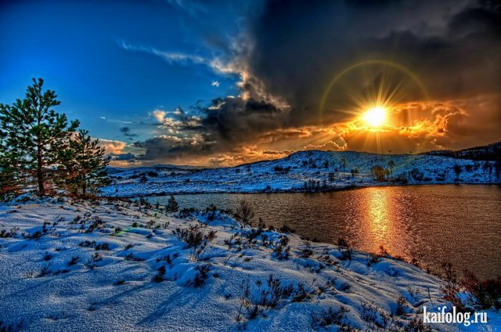
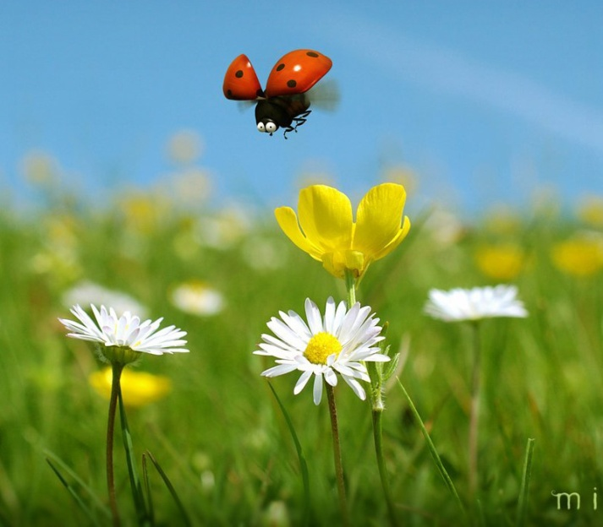
Beautiful landscapes

Slide 17
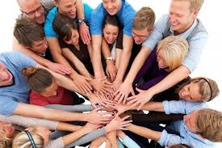
Friendly, helpful people

Slide 18
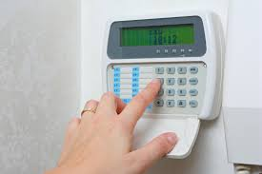
Alarm system

Slide 19
Peephole

Slide 20
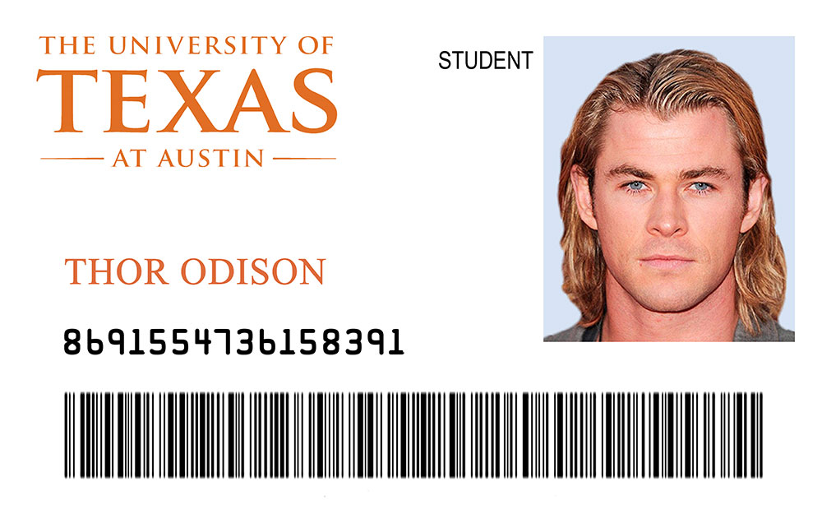
ID

Slide 21
Install

Slide 22
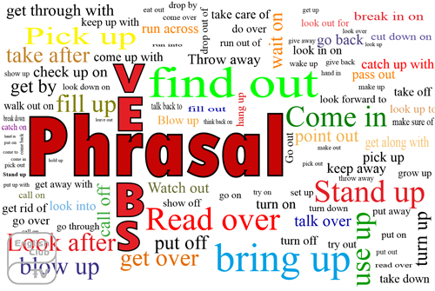

Slide 23
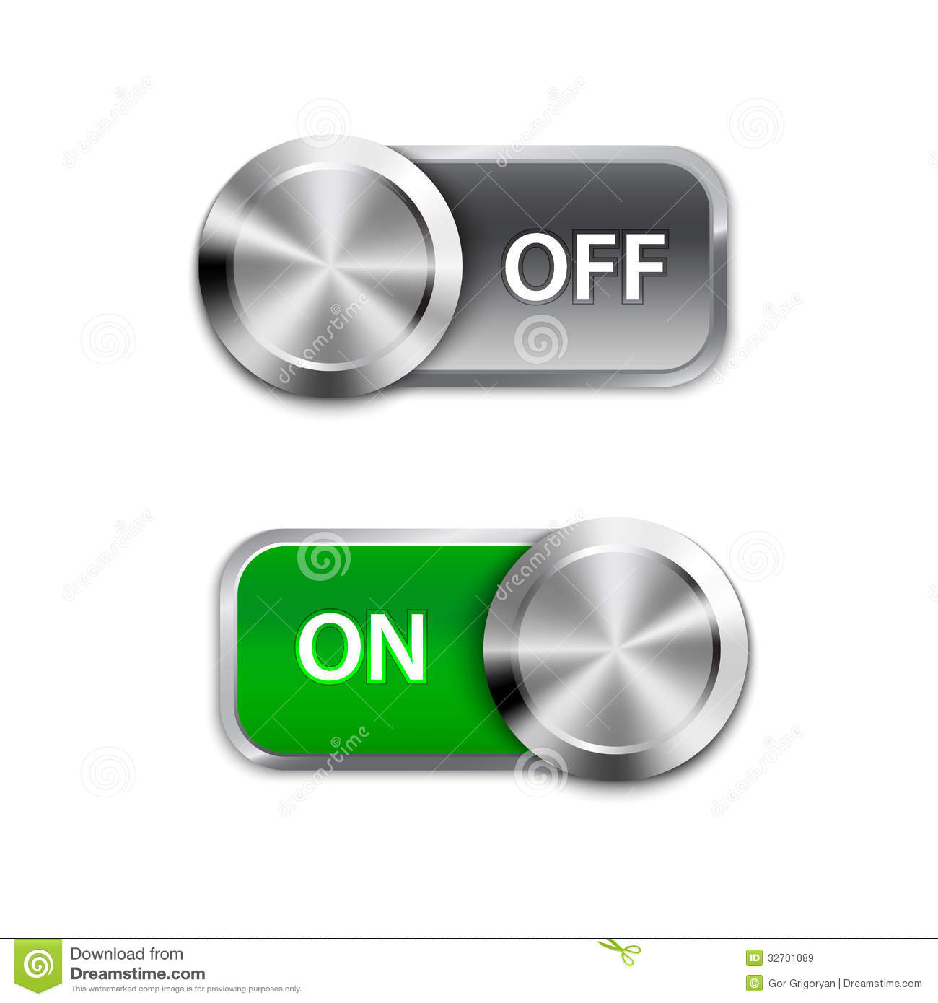
Switch on/Switch off

Slide 24
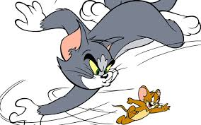
Run after

Slide 25
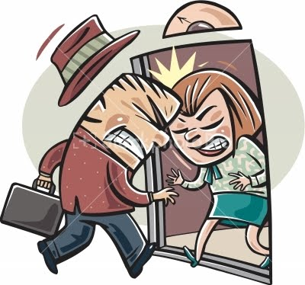
Run into

Slide 26
Hand over

Slide 27
Run out of

Slide 28
Surf the net – бродить по сети Интернет

Slide 29
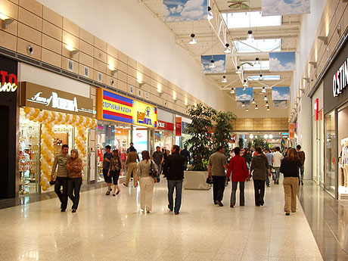
Hang out at the shopping centre – гулять по торговому центру

Slide 30
Close to hand – рукой подать

Slide 31
Homesick – тоскующий по дому
Feeling lonely away from home – чувство одиночества вдали от дома.

Slide 32
Translate from Russian into English
1) Я часто хожу по магазинам, кино и театрам.
I often go to shops, cinemas and theatres.
2) Джон любит проводить время на свежем воздухе.
Jhon loves to spend time in the fresh air.
3)Моей сестре не нравятся переполненные улицы.
My sister doesn't love crowded streets
4) Высокий уровень безработицы - это большая проблема для деревни.
High level of unemployment is a great problem in countryside.
5) Некоторые люди предпочитают чувство изолированности.
Some people prefer feeling isolated.

Slide 33
Fill in the gaps.
I enjoy peace and quiet most of all.
2)There are many beautiful landscapes in
countryside.
3)High quality lifestyle helps to be in good
health (быть здоровым)

Slide 34
Choose the correct word.
It’s a crime to look/break into a house.
It’s a crime to look/break into a house.
2) You are hometown/homesick.
You are hometown/homesick.
3)He’s installing/inventing outside.
He’s installing/inventing outside.
4) I hate the constant/crowded noise in Paris.
I hate the constant/crowded noise in Paris.
5) Everything is close/easy at hand.
Everything is close/easy at hand

Slide 35
CHOOSE THE CORRECT PREPOSITION
1. Many young people hang on/out at shopping centers in Mexico.
Many young people hang on/out at shopping centers in Mexico.
2.The police are running into/after burglar.
The police are running into/after burglar.
3.Mexican people are crazy of/about football.
Mexican people are crazy of/about football.
4.I’m running into/out of money.
I’m running into/out of money.

Slide 36
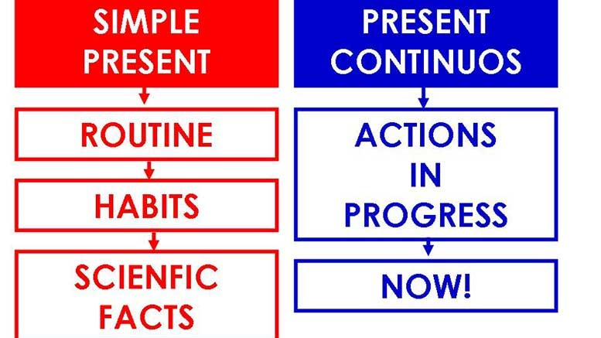
1. Many young people hang on/ou4.There are a lot of transport to choose in/from.
5. I ran out of/ into my friend in Mexico.
6. I’m running into/out of money.

Slide 38
Put the verbs in brackets into the present simple or the present continuous.
1.Jhon….(take) me to school every year.
Jhon takes me to school every year.
2…….(they/leave) Mexico city next week?
Are they leaving Mexico city next week?
3. She……(not/like) flying by plane.
She doesn’t like flying by plane.
4. The bus to Mexico City……(leave) at 9:00.
The bus to Mexico City leaves at 9:00.
5.Be quiet. The baby….(sleep) right now.
Be quiet. The baby is sleeping right now.
6. I can’t stand it! He….(always/take) my books.
I can’t stand it! He is always taking my books.

Slide 39
Use the phrases to give advice
1) A friend who is nervous about his exam. (not worry so much)
I am nervous about my exam. You shouldn’t worry so much.
2) A burglar breaks into a house. (hand over/ Valuables/go unnoticed(пройти незамеченным)
A burglar breaks into a house. You should hand over valuables and go unnoticed.
3) A son has a stomach ache(боль в животе) (wash hands/before meals(перед едой)
I have has a stomach ache. You should wash your hands before meals.
4)An alarm system works badly. (repair/it/tonight)
An alarm system works badly. You should be repairing it tonight.

