Slide 1
IRREGULAR VERBS
НЕПРАВИЛЬНЫЕ
ГЛАГОЛЫ

Slide 2
BE WAS, WERE быть, находиться

Slide 3
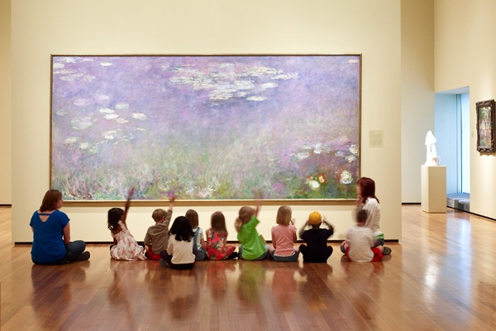
Выбери правильную форму глагола:
I am/was happy when I see my friends.
We are/were at the museum yesterday.
I am happy when I see my friends.
We were at the museum yesterday.

Slide 4
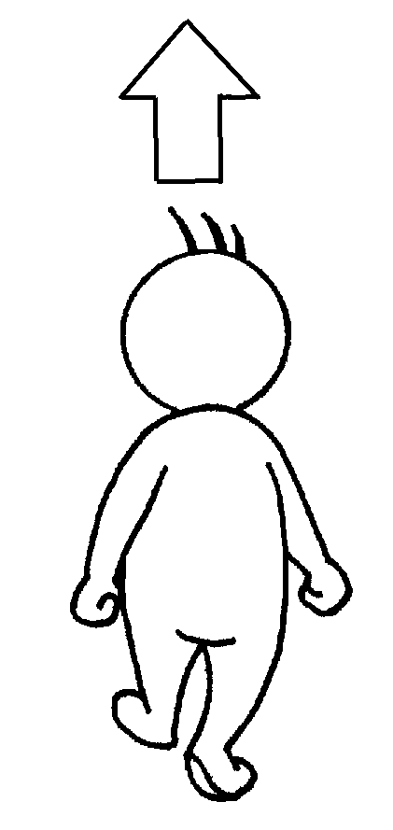
GO WENT
идти

Slide 5
Выбери правильную форму глагола:
In summer we always go to the seaside, but last year we went camping.
In summer we always go/went to the seaside, but last year we go/went camping.

Slide 6
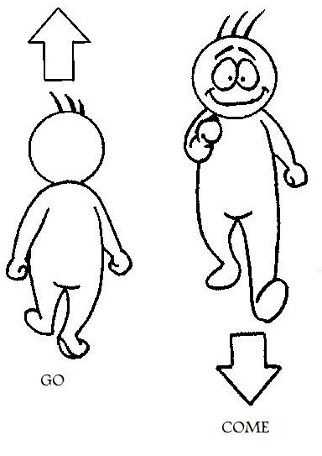
COME CAME
приходить,
приезжать

Slide 7
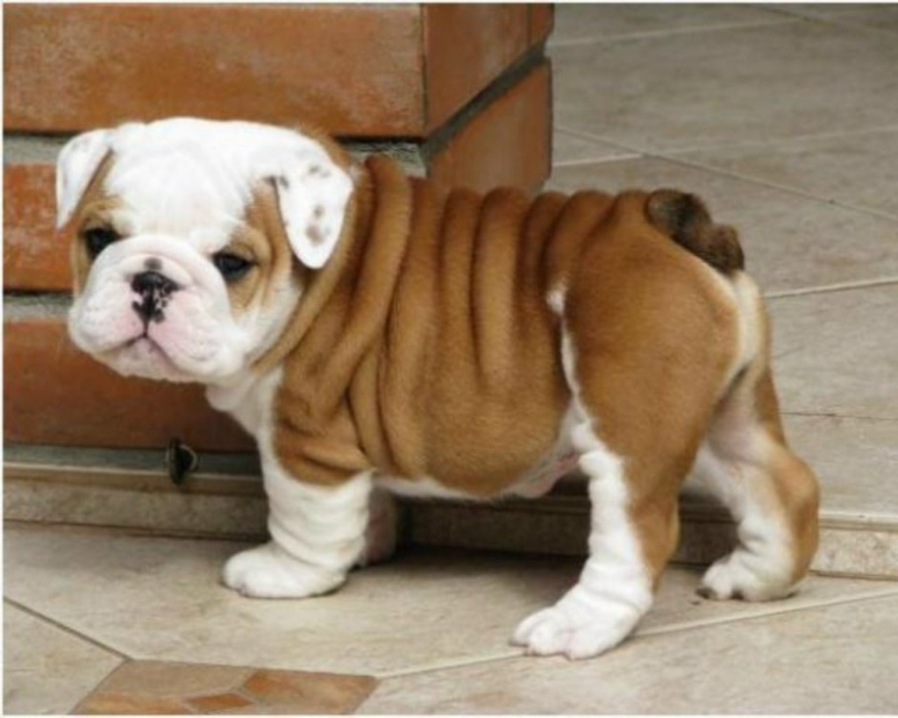
Выбери правильную форму глагола:
My grandparents often come/came to us at the weekend.
Last weekend they come/came to us with their dog. I am/was happy!
My grandparents often come to us at the weekend.
Last weekend they came to us with their dog. I was happy!

Slide 8
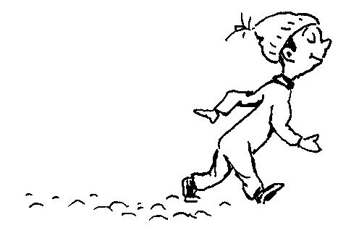
LEAVE
LEFT
покидать,
уезжать

Slide 9
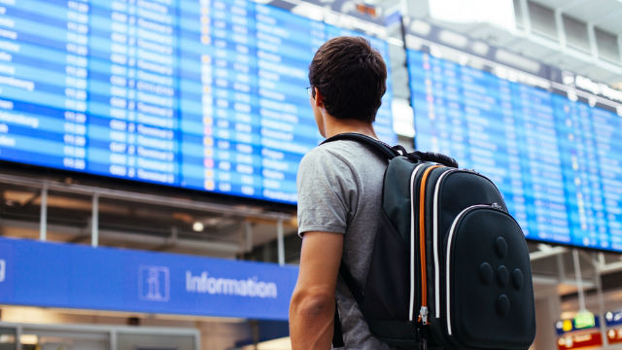
Выбери правильную форму глагола:
My brother lives in a big city. He visited us in summer and I was very sad when he leaves/left us.
My brother lives in a big city. He visited us in summer and I was very sad when he left us.

Slide 10
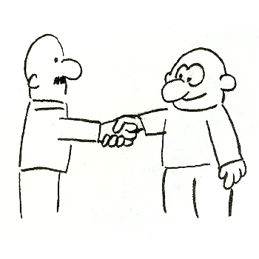
MEET
MET
встречать(ся)
знакомиться

Slide 11
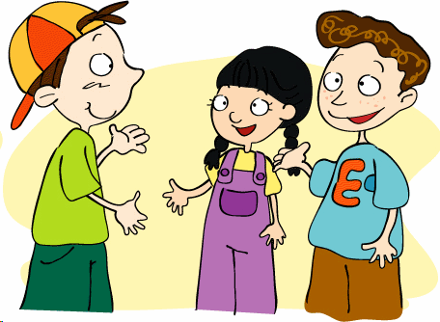
Выбери правильную форму глагола:
After school my friends and I always meet/met at the park. Yesterday we meet/met at 5 o’clock in the evening and go/went to the cafe.
After school my friends and I always meet at the park. Yesterday we met at 5 o’clock in the evening and went to the cafe.

Slide 12
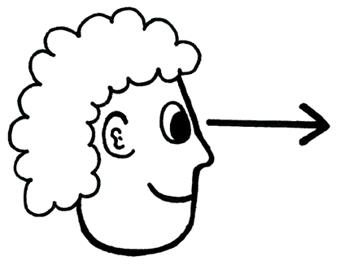
SEE SAW
видеть

Slide 13
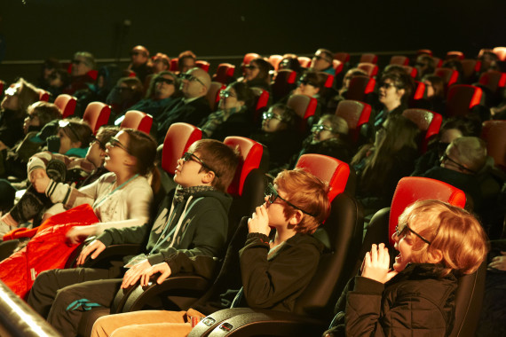
Выбери правильную форму глагола:
I see/saw my cousins very often.
We went to the cinema last Sunday and see/saw a great 4D film.
I see my cousins very often.
We went to the cinema last Sunday and saw a great 4D film.

Slide 14
WRITE
WROTE
писать

Slide 15
Выбери правильную форму глагола:
Ann writes/wrote very interesting stories for her little sister. Two days ago she writes/wrote a very funny story and her sister was very happy.
Ann writes very interesting stories for her little sister. Two days ago she wrote a very funny story and her sister was very happy.

Slide 16
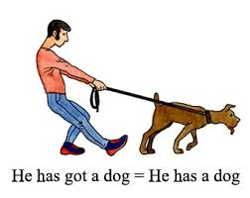
HAVE
HAD
иметь

Slide 17
Выбери правильную форму глагола:
We always have/had five lessons every day but yesterday there were only three lessons because we have/had a school party!
We always have five lessons every day but yesterday there were only three lessons because we had a school party!

Slide 18
RIDE
RODE
кататься верхом
(на велосипеде, на лошади)

Slide 19
Выбери правильную форму глагола:
My best friend Kate rides/rode her bike every day. Last weekend we go/went to the park together and ride/rode our bikes there. We have/had a lot of fun!
My best friend Kate rides her bike every day. Last weekend we went to the park together and rode our bikes there. We had a lot of fun!

Slide 20
DRIVE
DROVE
водить машину

Slide 21
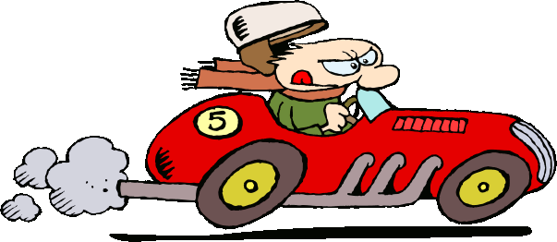
Выбери правильную форму глагола:
My uncle usually drives/drove his car very well, but yesterday he drives/drove it very fast. We are/were very angry!
My uncle usually drives his car very well, but yesterday he drove it very fast. We were very angry!

Slide 22
SING
SANG
петь

Slide 23
Выбери правильную форму глагола:
We sing at our Music lessons
on Mondays. Two days ago we sang for our parents at the concert. They liked it!
We sing/sang at our Music lessons
on Mondays. Two days ago we sing/sang for our parents at the concert. They liked it!

Slide 24
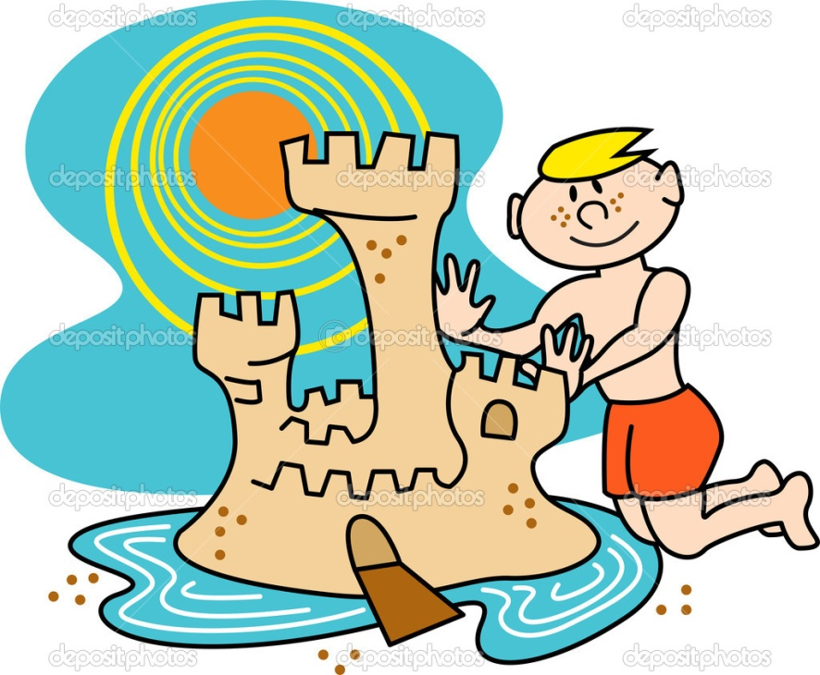
MAKE
MADE
делать, готовить,
изготавливать

Slide 25
Выбери правильную форму глагола:
My big sister likes cooking. She always makes/made some yummy things at the weekends. Last Sunday she makes/made a beautiful cake for our mum.
My big sister likes cooking. She always makes some yummy things at the weekends. Last Sunday she made a beautiful cake for our mum.

Slide 26
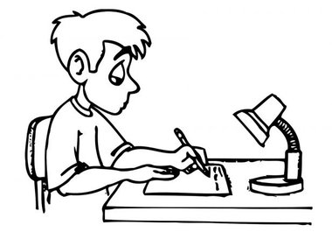
DO
DID
делать (домашнюю работу)

Slide 27
Выбери правильную форму глагола:
I usually do/did my homework and then go for a walk. But yesterday I do/did my homework and didn’t go/went outside because it was rainy.
I usually do my homework and then go for a walk. But yesterday I did my homework and didn’t go outside because it was rainy.

Slide 28
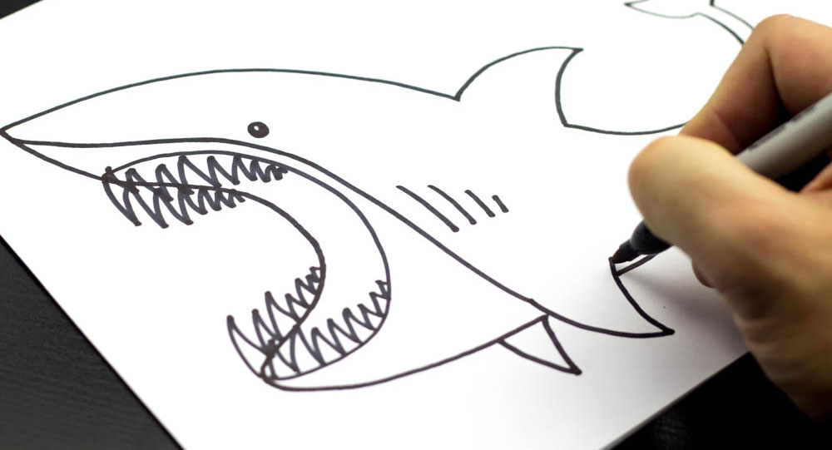
DRAW
DREW
рисовать

Slide 29
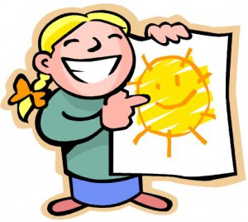
Выбери правильную форму глагола:
I often draw because I like it. Yesterday I drew the sun for my little brother. He was happy!
I often draw/drew because I like it. Yesterday I draw/drew the sun for my little brother. He was happy!

Slide 30
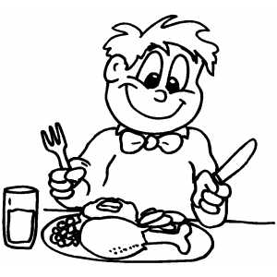
EAT
ATE
есть

Slide 31
Выбери правильную форму глагола:
I usually eat/ate fish and chips for lunch but yesterday I eat/ate rice.
I usually eat fish and chips for lunch but yesterday I ate rice.

Slide 32
DRINK
DRANK
пить

Slide 33
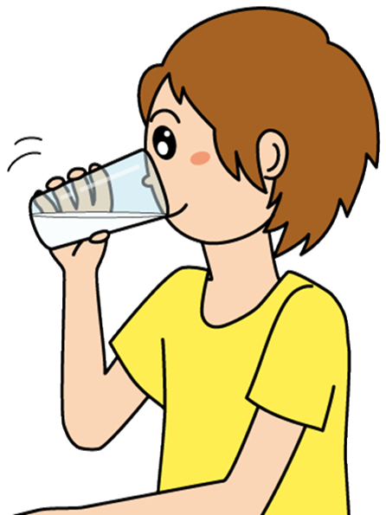
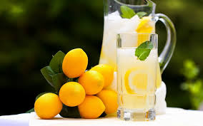
Выбери правильную форму глагола:
I usually drink/drank lemonade in summer, but yesterday I was ill and I drink/drank hot milk.
I usually drink lemonade in summer, but yesterday I was ill and I drank hot milk.

Slide 34
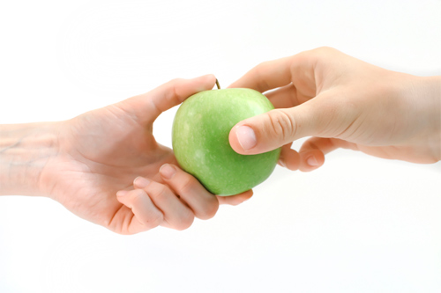
GIVE
GAVE
давать
TAKE
TOOK
брать,
брать с собой

Slide 35
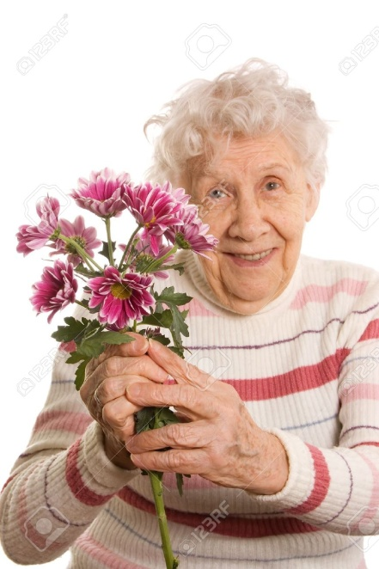
Выбери правильную форму глагола:
My granny always gives/gave me yummy things when I visit her. Last weekend she come/came to see us. I give/gave her flowers and she takes/took them home.
My granny always gives me yummy things when I visit her. Last weekend she came to see us. I gave her flowers and she took them home.

Slide 36
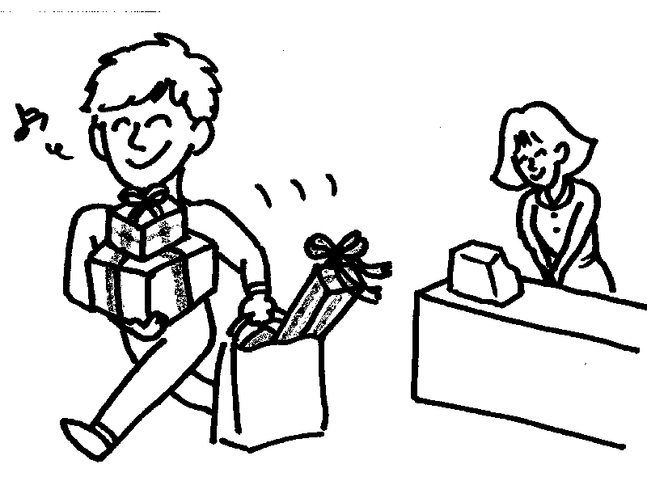
BUY
BOUGHT
покупать

Slide 37
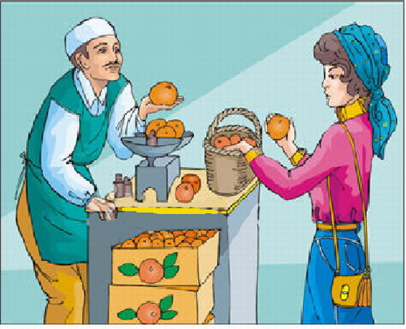
Выбери правильную форму глагола:
Mrs Twitt usually buys/bought fruit at the supermarket but yesterday she buys/bought some oranges at the greengrocer’s.
Mrs Twitt usually buys fruit at the supermarket but yesterday she bought some oranges at the greengrocer’s.

Slide 38
WIN
WON
выиграть, победить

Slide 39
Выбери правильную форму глагола:
Bob can run very fast.
He always wins/won races at school.
He wins/won a race a week ago too!
Bob can run very fast.
He always wins races at school.
He won a race a week ago too!

Slide 40
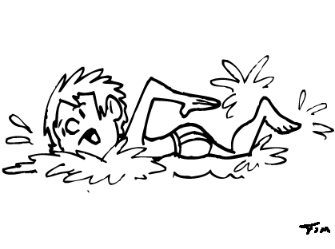
SWIM
SWAM
плавать

Slide 41
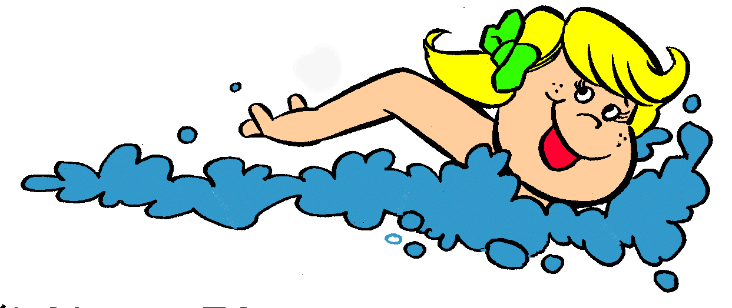
Выбери правильную форму глагола:
Pat swims/swam in the swimming pool twice a week. Last Saturday she swims/swam a race. She wins/won it!
Pat swims in the swimming pool twice a week. Last Saturday she swam a race. She won it!

Slide 42
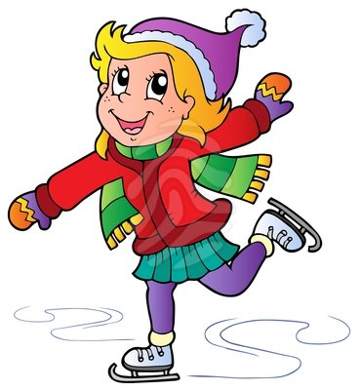
Выбери правильную форму глагола:
CAN
COULD
уметь
She can’t/couldn’t skate last year but now she can/could skate very well!
She couldn’t skate last year but now she can skate very well!

Slide 43
THE END. GOOD JOB!

